Slide 1
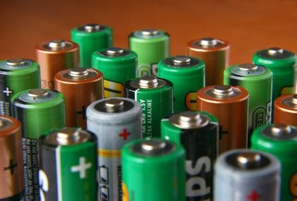
Section 5: Electric Potential

Slide 2
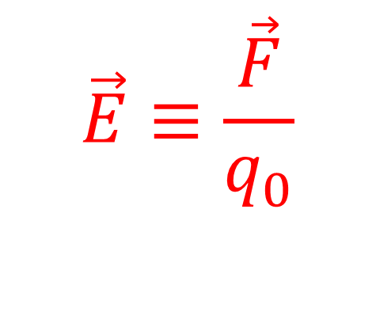
Questions
How many objects does it take to have an electric force?
How many objects does it take to create an electric field??
$$\vec{E}≡\frac{\vec{F}}{q_{0}}$$

Slide 3
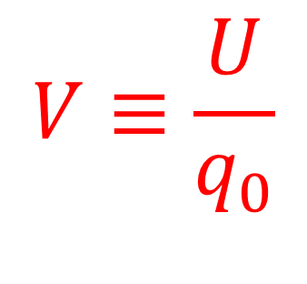
Questions
How many objects does it take to have electric potential energy?
How many objects does it take to create an electric potential field?
$$V≡\frac{U}{q_{0}}$$

Slide 4
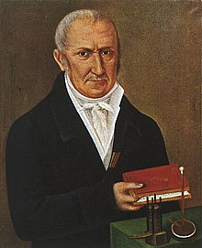
Electric Potential Units
SI Unit: Volt (V) = 1 J/C

Slide 5
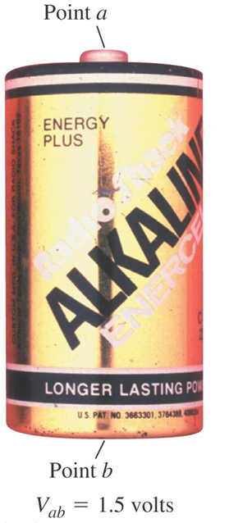

Electric Potential Difference
$$V_{ab}≡V_{a}−V_{b}$$
Potential difference is often called voltage.

Slide 6
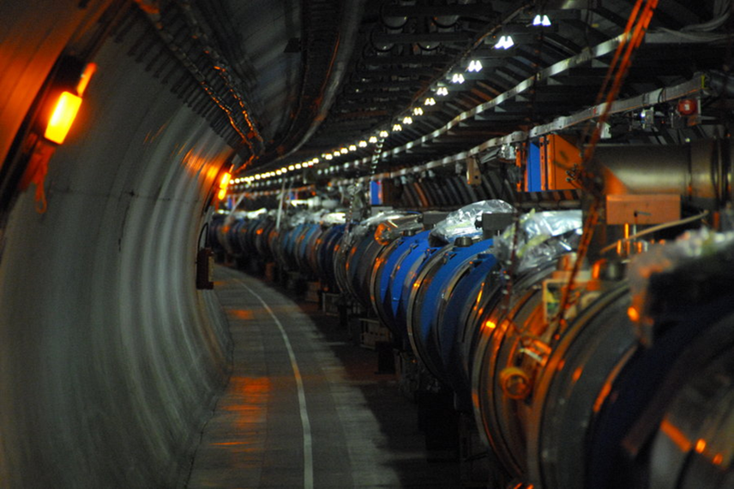


Electron Volts
1 electron volt (eV) $=1.602×{10}^{−19} \text{J}$

Slide 7
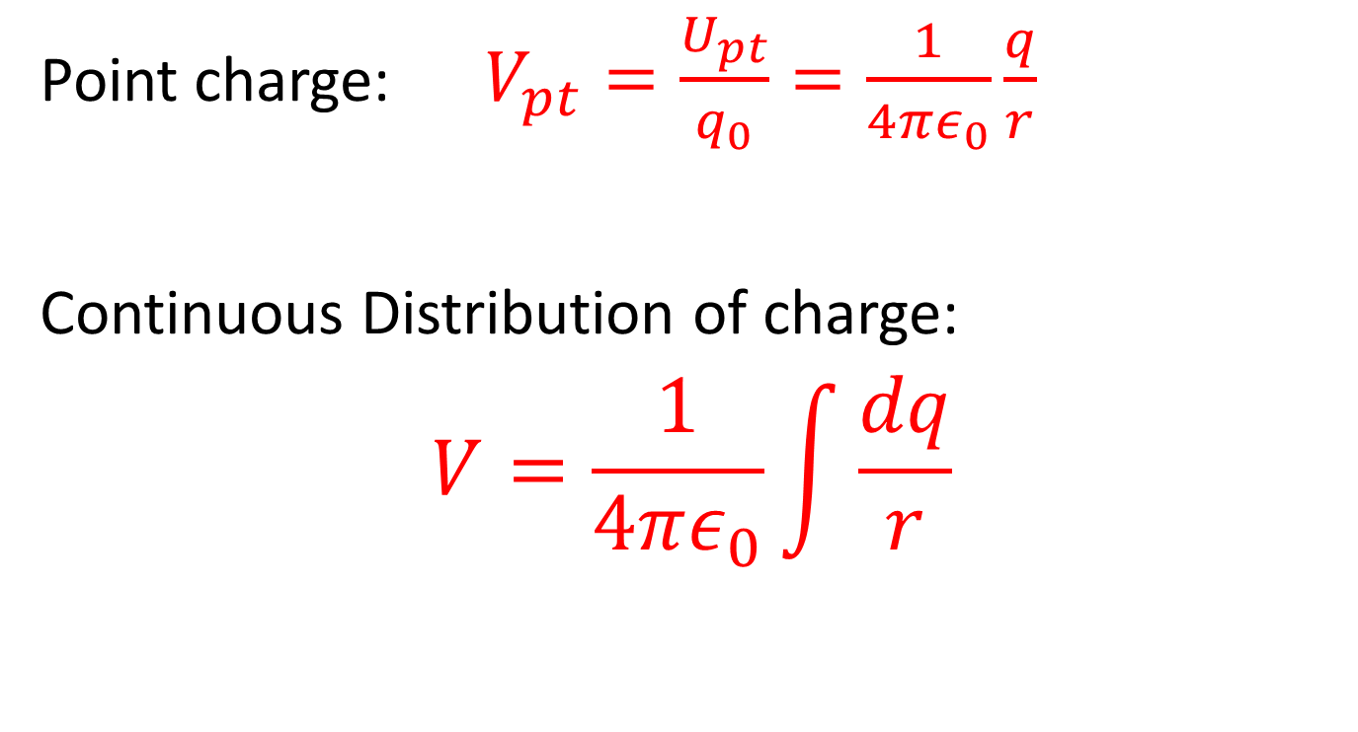
Electric Potential: Superposition
Point charge: $V_{pt}=\frac{U_{pt}}{q_{0}}=\frac{1}{4πε_{0}}\frac{q}{r}$
Continuous Distribution of charge:
$$V=\frac{1}{4πε_{0}}\int{\frac{dq}{r}}$$

Slide 8
Example: Electric Potential and Work – Point Charges

Slide 9

Potential From Electric Field
$$V_{a}−V_{b}=−\int_{b}^{a}{\vec{E}·d\vec{l}}$$
If we know the electric field, we can find the potential difference!

Slide 10
Example: Parallel Plates and Electric Potential

Slide 11
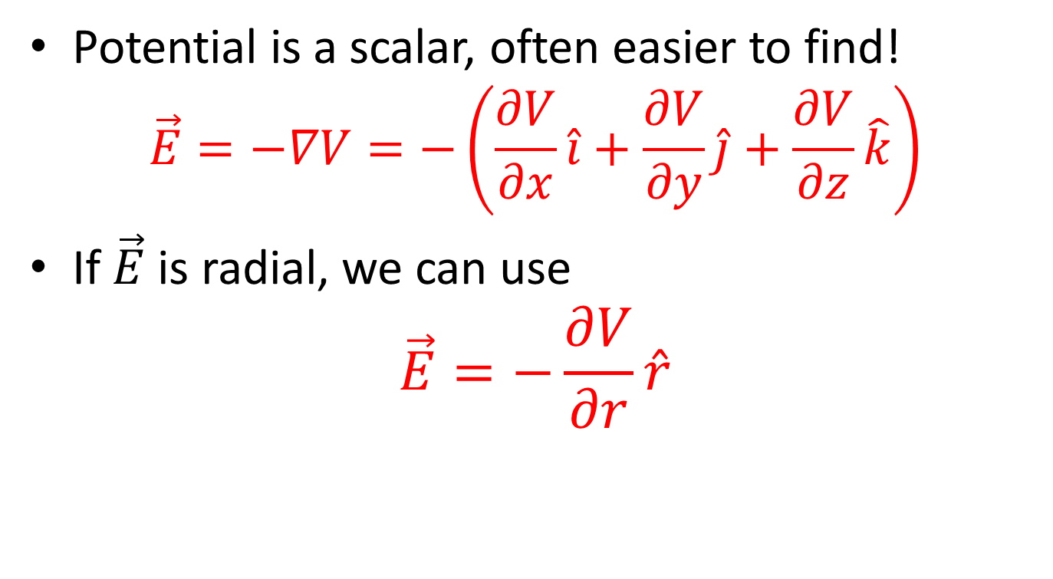
Electric Field from Potential
Potential is a scalar, often easier to find!
$$\vec{E}=−∇V=−\left(\frac{∂V}{∂x}\hat{i}+\frac{∂V}{∂y}\hat{j}+\frac{∂V}{∂z}\hat{k}\right)$$
If $\vec{E}$ is radial, we can use
$$\vec{E}=−\frac{∂V}{∂r}\hat{r}$$

Slide 12
Example: Electric Field from Electric Potential

Slide 13
Activity: Relations in Electrostatics

Slide 14
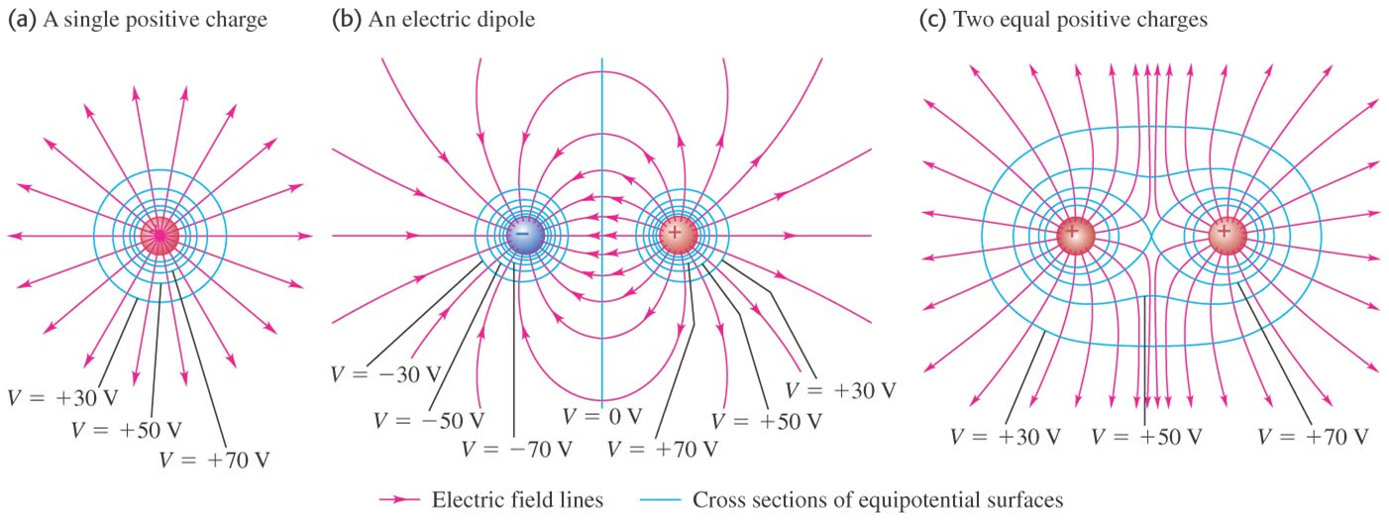
Equipotential Surfaces
Surfaces along which potential is equal!

Slide 15
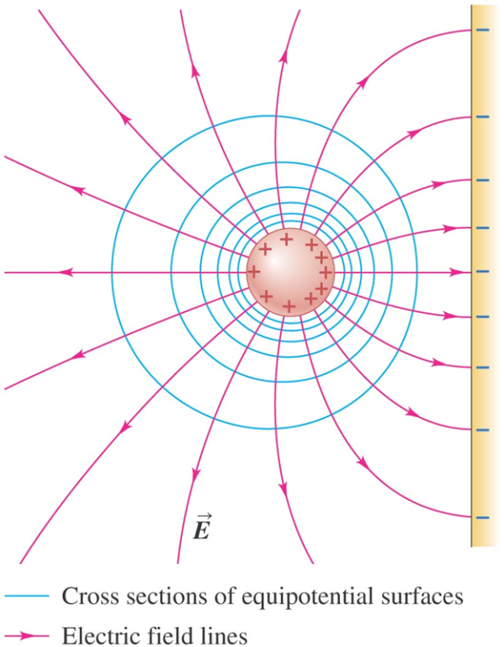
Potential and Conductors
Conductors are always equipotentials. Why??

Slide 16
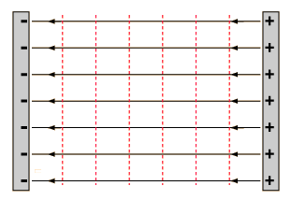
Equipotential Lines for Parallel Plates

Slide 17

Activity: Electron Accelerator

Slide 18
Labs: Electric Potential I and II

